Slide 1
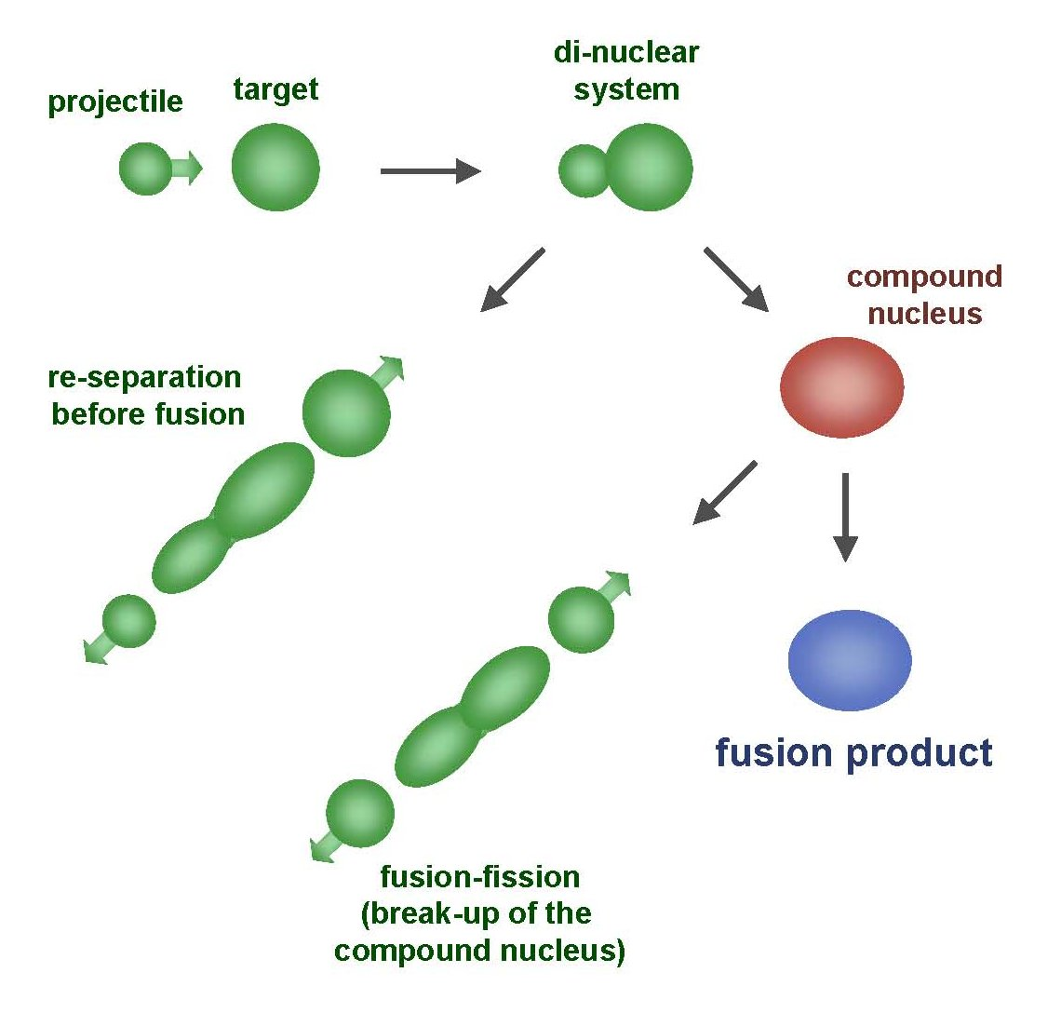

RDCH 702: Lecture 3, Nuclear Reactions Part 2
Readings: Modern Nuclear Chemistry, Chapter 10; Nuclear and Radiochemistry, Chapter 4
Notation
Energetics of Nuclear Reactions
Reaction Types and Mechanisms
  Barriers
  Scattering
Nuclear Reaction Cross Sections
Reaction Observables
Scattering
Direct Reactions
Compound Nuclear Reactions
Photonuclear Reactions
Nucleosynthesis

Slide 2
Reactions: Elastic Scattering
Elastic scattering
  kinetic energy conserved
  Particles do not change
Simplest consequence of a nuclear collision
  Not a “reaction”
    no exchange of nucleons or creation of particles
Particles do not change their identity during the process and the sum of their kinetic energies remains constant
Elastic scattering will also have a contribution from nuclear forces

Slide 3
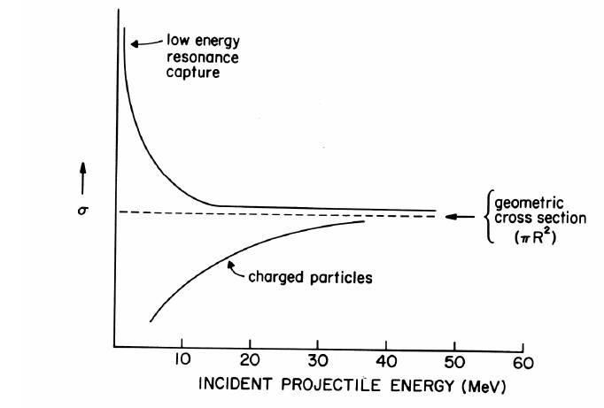
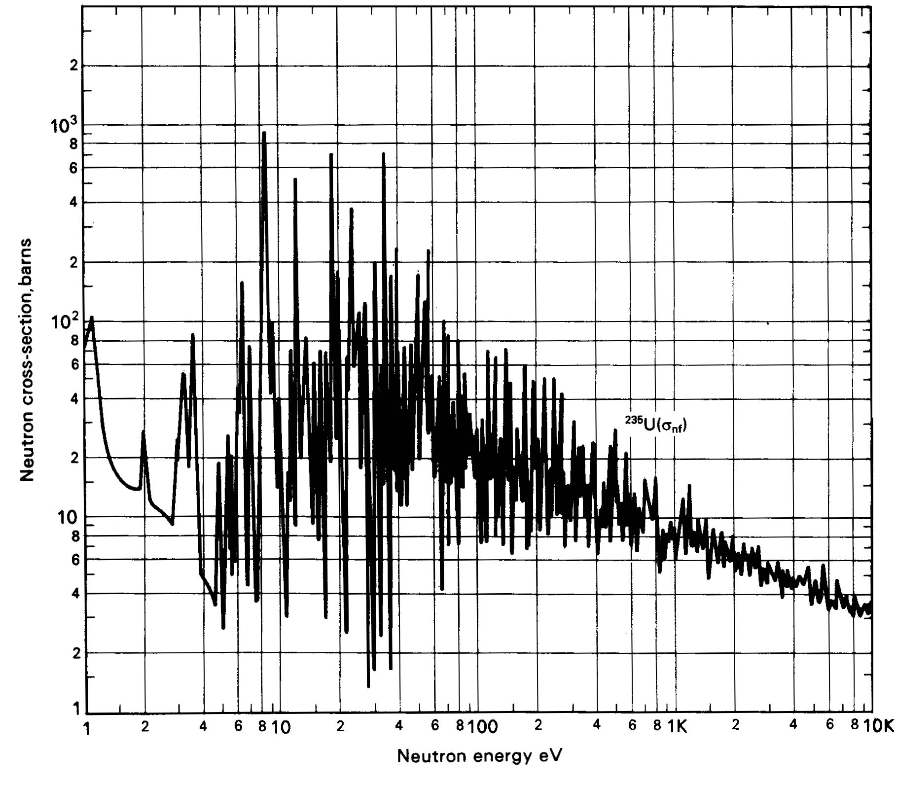
Low-Energy Reactions with Light Projectiles
Slow-Neutron Reactions
  Purest example of compound-nucleus behavior
    1/v law governs most neutron cross sections in region of thermal energies
  neutrons available only from nuclear reactions
    Range of energies can be obtained
Reaction Cross Sections
  Coulomb barrier prevents study of nuclear reactions with charged particles below 1 MeV
    resonances no longer observable
    with increasing energy, increasing variety of reactions possible

Slide 4
Low-Energy Reactions
Deuteron Reactions
  Prevalence of one nucleon stripping
    large size and loose binding of deuteron
    Only proton and neutron in deuteron nucleus
      Proton charge carries both nucleons
  Neutron comes within range of nuclear forces while proton is still outside most of Coulomb barrier
    Inherent in large neutron-proton distance in deuteron
    weakly bound deuteron can be broken up
      proton outside barrier
Competition among Reactions
  depends on relative probabilities for emission of various particles from compound nucleus
    determined by number of factors
      energy available
      Coulomb barrier
      density of final states in product nucleus

Slide 5
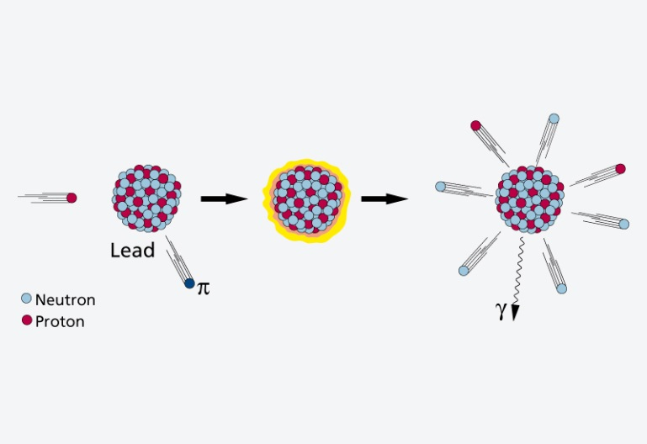
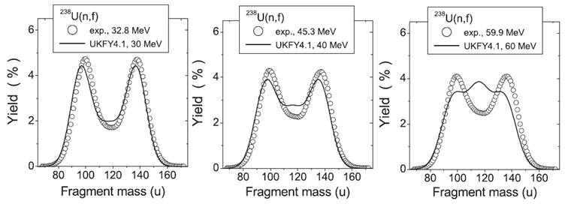
High Energy Reactions
Spallation Products
  products in immediate neighborhood of target element found in highest yields
    within 10 to 20 mass numbers
  yields tend to form in two regions
  β stability for medium-weight products
  neutron-deficient side of stability with increasing Z of products
  Used to produce beam of neutrons at spallation neutron source
    Heavy Z will produce 20-30 neutrons
    Basis of Spallation neutron source (http://neutrons.ornl.gov/facilities/SNS/)
High-Energy Fission
  single broad peak in mass-yield curve instead of double hump seen in thermal-neutron fission
  many neutron-deficient nuclides
    especially among heavy products
    originate from processes involving higher deposition energies
    lower kinetic energies
    do not appear to have partners of comparable mass
    arise from spallation-like or fragmentation reactions

Slide 6
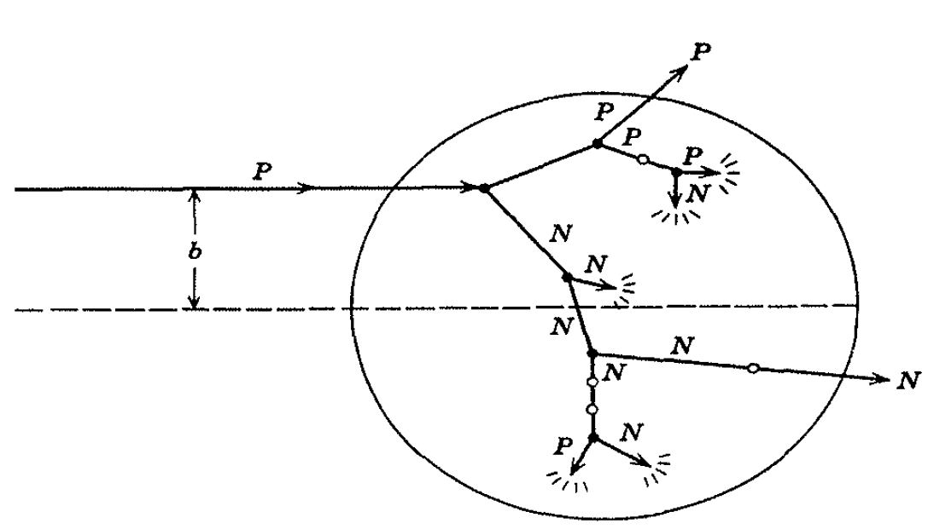
High-Energy Reactions
Mass-Yield Curves
  at low energies, compound-nucleus picture dominates
    as energy increases importance of direct reactions and preequilibrium (pre-compound nucleus) emission increase
    above 100 MeV, nuclear reactions proceed nearly completely by direct interactions
  products down to mass number 150 are spallation products
  those between mass numbers 60 and 140 are fission products
Cascade-Evaporation Model
  Above 100 MeV reactions
  energy of the incident proton larger than interaction energy between the nucleons in the nucleus
  Wavelength less than average distance between nucleons
    proton will collide with one nucleon at a time within the nucleus
      high-energy proton makes only a few collisions in nucleus
      Produces nucleons with high energy

Slide 7
Heavy-Ion Reactions
Range of heavy ion reactions
  elastic and inelastic scattering
  compound-nucleus formation,
  direct interactions
  deeply inelastic reaction
Reactions influence by parameter
  impact parameter of collision
  kinetic energy of projectile
  masses of target
  projectile nuclei
Elastic and Inelastic Scattering, Coulomb Excitation
  elastic-scattering measurements used to obtain information on interaction radii
  R=R₁+R₂ between mass numbers A₁ and A₂

Slide 8
Heavy Ion Reactions
Inelastic scattering
  scattering in which some of projectile’s kinetic energy transformed into excitation of target nucleus
    greatest importance at large impact parameters
  heavy ions valuable
    can excite high-spin states in target nuclei because of large angular momenta
Can experience Coulomb excitation
  high charges
  below Coulomb barrier heights and excite nuclei by purely electromagnetic interactions
Transfer Reactions
  stripping and pickup reactions prevalent with heavy ions
    take place at impact parameters just below those at which interactions are purely Coulombic
  angular distributions show oscillatory, diffraction-like pattern when transfer reaction to single, well-defined state observed

Slide 9
Heavy Ion Reactions: Deep Inelastic Reactions
Relatively large amounts of nuclear matter transferred between target and projectile
  Show strongly forward-peaked angular distributions
  “Grazing contact mechanism”
Products with masses in vicinity of projectile mass appear at angles other than classical grazing angle
  Relatively small kinetic energies
Total kinetic energies of products strongly correlated with amount of mass transfer
  Increasing mass difference of product and projectile lowers kinetic energy
Product will dissociate into two fragments
  Appreciable fraction of incident kinetic energy dissipated and goes into internal excitation

Slide 10
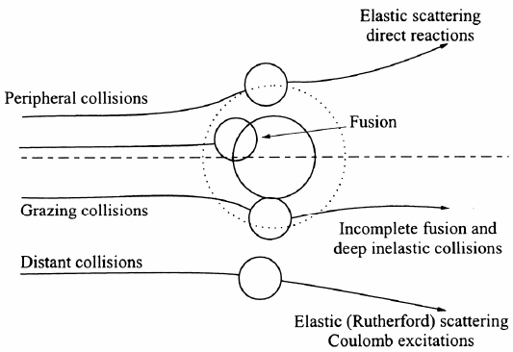
Compound-Nucleus Reactions
Compound-nucleus formation can only take place over a restricted range of small impact parameters
  can define critical angular momentum above which complete fusion cannot occur
  σ_{cf}/σ_{R} decreases with increasing bombarding energy
Neutron deficient heavy ions produce compound nuclei on neutron-deficient side of β stability belt
Heavy ion of energy above Coulomb barrier brings enough excitation energy to evaporate several nucleons
  5-10 MeV deexcitation for neutron evaporation
heavy-ion reactions needed for reaching predicted island of stability around Z=114 to N=184
U is excitation energy, M_{A} and M_{a} masses of target and projectile, T_{a} is projectile kinetic energy, S_{a} is projectile binding energy in compound nucleus

Slide 12
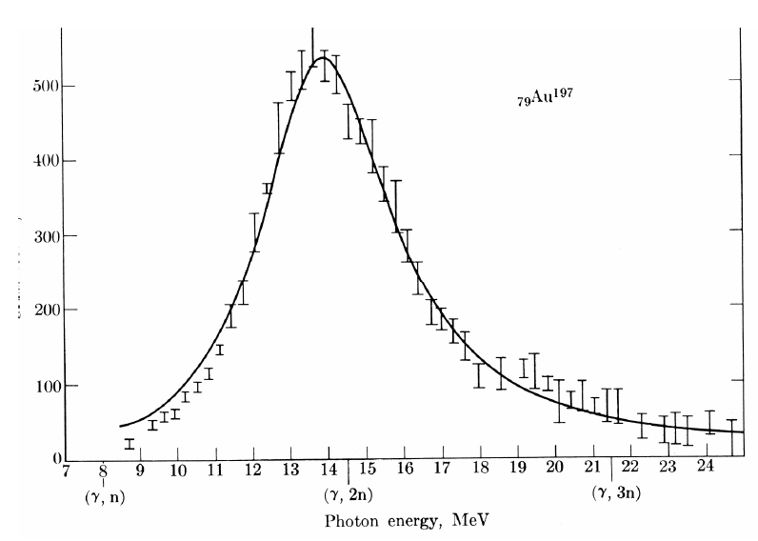
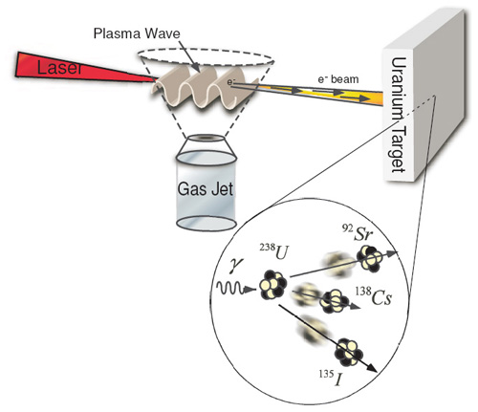
Photonuclear reactions
Reactions between nuclei and low- and medium-energy photons dominated by giant resonance
  Excitation function for photon absorption goes through a broad maximum a few MeV wide
    Due to excitation of dipole vibrations of protons against neutrons in the nucleus
Resonance peak varies smoothly with A
  24 MeV at ¹⁶O
  13 MeV at ²⁰⁹Bi
Peak cross sections are 100-300 mb
(γ, p), (γ, n), (γ,α) reactions
http://www.engin.umich.edu/research/cuos/ResearchGroups/HFS/Research/photonuclear_reactions.html

Slide 13
Natural Element Production
Nuclear Astrophysics
  fundamental information on the properties of nuclei and their reactions to the
  perceived properties of astrological objects
  processes that occur in space
Nuclear reactions responsible for production of elements
  Occurs in stars
At temperatures and densities
  light elements are ionized and have high enough thermal velocities to induce a nuclear reaction
  heavier elements were created by a variety of nuclear processes in massive stellar systems
systems must explode to disperse the heavy elements
  distribution of isotopes here on earth
underlying information on the elemental abundances
nuclear processes to produce the primordial elements

Slide 14
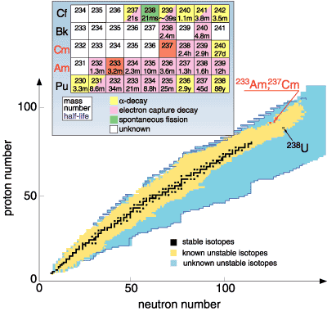
Chart of the nuclide trends
Actinides some distance from stable elements

Slide 15
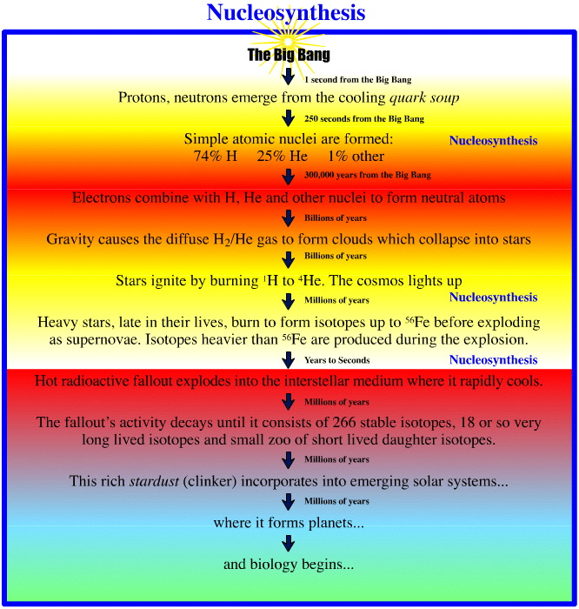
Timeline
Big bang 15E9 years ago
Temperature 1E9 K
Upon cooling influence of forces felt
  2 hours
    H (89 %) and He (11 %)
  Free neutrons decay

Slide 16
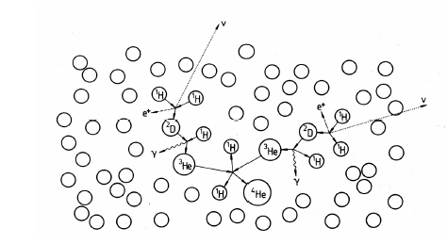
Origin of Elements
Gravitational coalescence of H and He into clouds
Increase in temperature to fusion
Proton reaction
  ¹H + n → ²H + γ
  ²H + ¹H → ³He
  ²H + n → ³H
  ³H + ¹H → ⁴He + γ
  ³He + n → ⁴He + γ
  ³H + ²H → ⁴He + n
  ²H + ²H → ⁴He + γ
  ⁴He + ³H → ⁷Li + γ
  ³He+⁴He → ⁷Be + γ
    ⁷Be short lived
    Initial nucleosynthesis lasted 30 minutes
      Consider neutron reaction and free neutron half life
Further nucleosynthesis in stars
  No EC process in stars

Slide 17
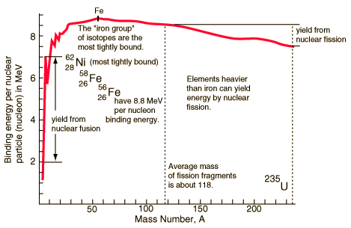
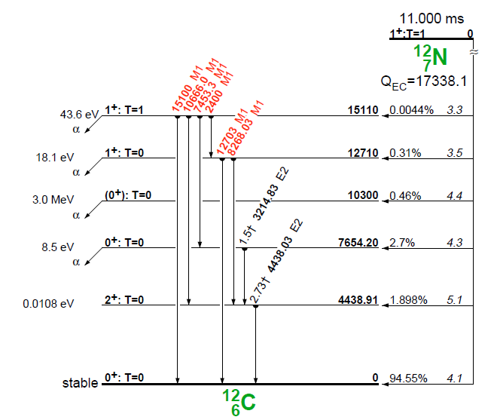
Stellar Nucleosynthesis
He burning
  ⁴He + ⁴He ↔ ⁸Be + γ - 91.78 keV
    Too short lived
  3 ⁴He → ¹²C + γ + 7.367 MeV
  ¹²C + ⁴He →¹⁶O
  ¹⁶O + ⁴He →²⁰Ne
Formation of ¹²C based on Hoyle state
  Excited nuclear state
    Somewhat different from ground state ¹²C
  Around 7.6 MeV above ground state
  0+
Fusion up to Fe
  From binding energy curve
  Maximum at Fe

Slide 18
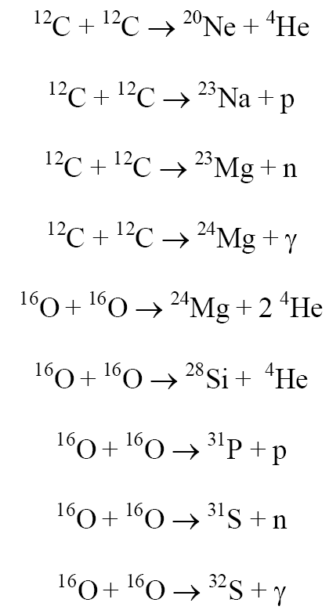
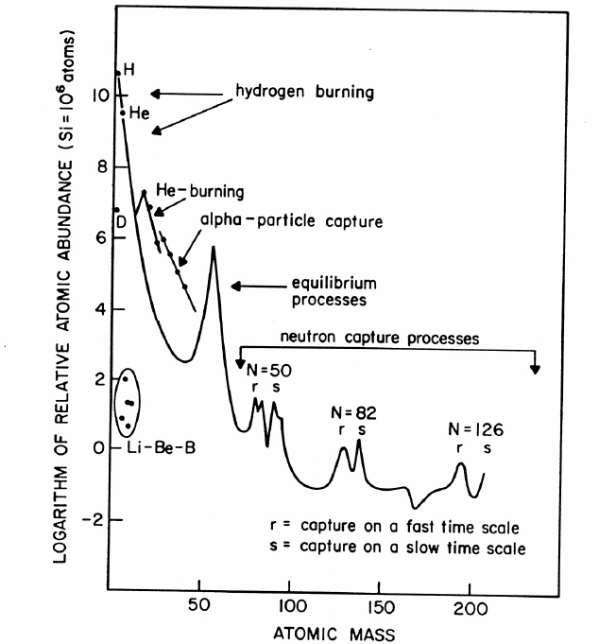
Stellar Nucleosynthesis
CNO cycle
  ¹²C + ¹H →¹³N + γ
  ¹³N →¹³C + e⁺+ νe
  ¹³C + ¹H →¹⁴N + γ
  ¹⁴N + ¹H →¹⁵O + γ
  ¹⁵O →¹⁵N + e⁺ + νe
  ¹⁵N + ¹H →¹²C + ⁴He
  Net result is conversion of 4 protons to alpha particle
    4 ¹H → ⁴He +2 e⁺+ 2 νe +3 γ

Slide 19
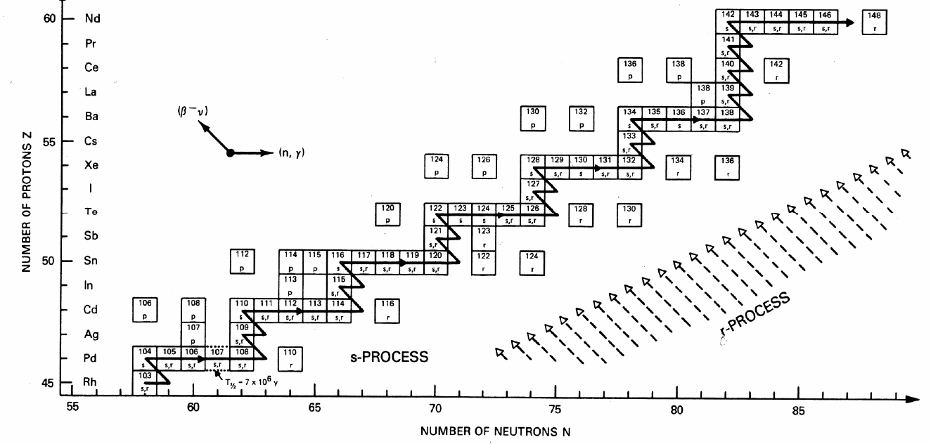
Formation of elements A>60
Neutron Capture; S-process
  A>60
  ⁶⁸Zn(n, γ) ⁶⁹Zn, ⁶⁹Zn → ⁶⁹Ga + β⁻ + ν
  mean times of neutron capture reactions longer than beta decay half-life
    Isotope can beta decay before another capture
  Up to Bi

Slide 20
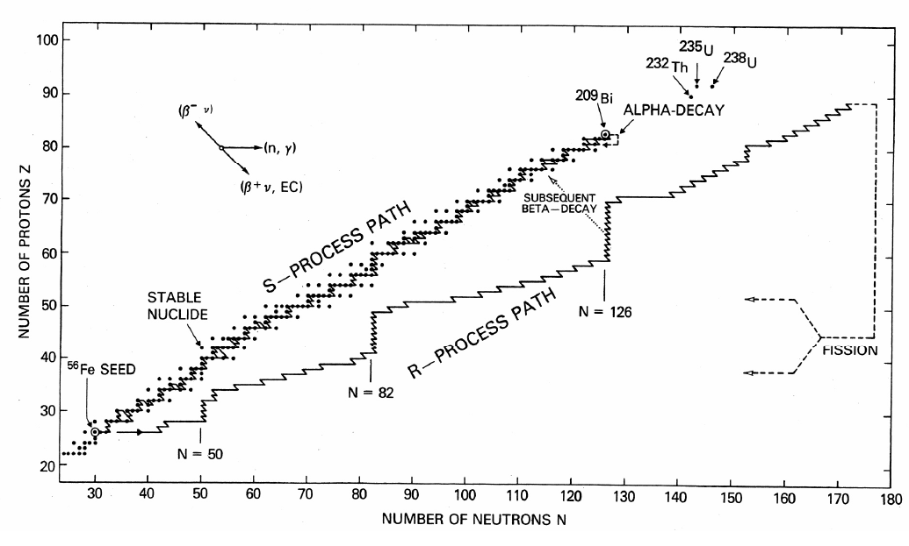
Nucleosynthesis: R process
Neutron capture time scale very much less than β- decay lifetimes
Neutron density 10²⁸/m³
  Extremely high flux
  capture times of the order of fractions of a second
  Unstable neutron rich nuclei
rapidly decay to form stable neutron rich nuclei
all A<209 and peaks at N=50,82, 126 (magic numbers)

Slide 21
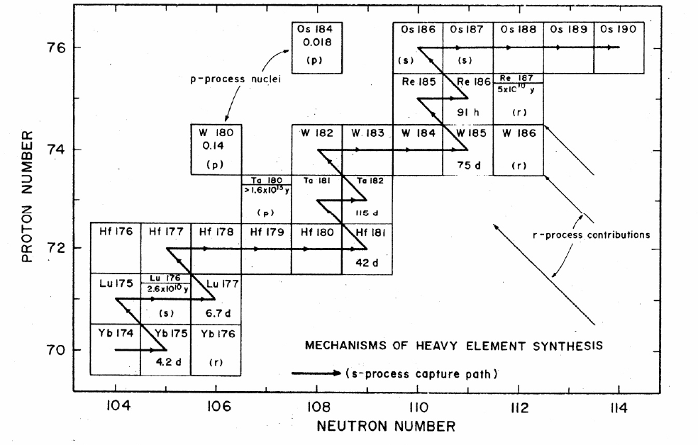
P process
Formation of proton rich nuclei
Proton capture process
70<A<200
Photonuclear process, at higher Z (around 40)
  (γ, p), (γ,α), (γ, n)
  ¹⁹⁰Pt and ¹⁶⁸Yb from p process
Also associated with proton capture process (p,γ)
Variation on description in the literature

Slide 22
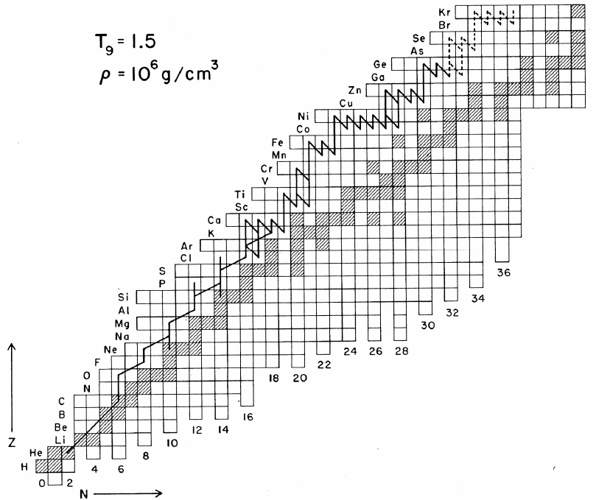
rp process
(rapid proton capture)
Proton-rich nuclei with Z = 7-26
  Forms a small number of nuclei with A< 100
(p,γ) and β⁺ decays that populate the p-rich nuclei
  Also associated with rapid proton capture process
Initiates as a side chain of the CNO cycle
  ²¹Na and ¹⁹Ne

Slide 23
Review Notes
Understand Reaction Notation
Understand Energetics of Nuclear Reactions
  Q values and barriers
Understand the Different Reaction Types and Mechanisms
  Particles
  Energy
Relate cross sections to energy
Describe Photonuclear Reactions
Routes and reactions in nucleosynthesis
Influence of reaction rate and particles on nucleosynthesis

Slide 24
Questions
Describe the different types of nuclear reactions for heavy ions.
Provide notations for the following
  Reaction of ¹⁶O with ²⁰⁸Pb to make stable Au
  Formation of Pu from Th and a projectile
Find the threshold energy for the reaction of ⁵⁹Co and an alpha that produces a neutron and a product nuclei
What are the differences between low and high energy reactions?
How does a charged particle reaction change with energy? A neutron reaction?
How are actinides made in nucleosynthesis?
What is the s-process?
What elements were produced in the big bang?
Which isotopes are produced by photonuclear reactions?
What is interesting about the production of ¹²C

Slide 25
Question
Respond to PDF Quiz
Comment in blog

